Slide 1
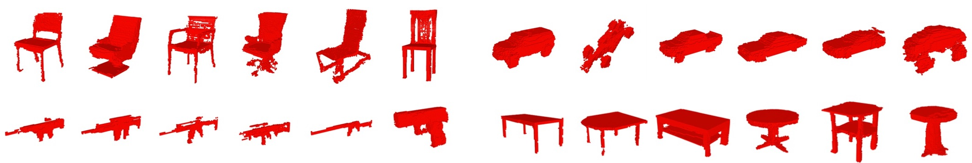
3D model Generation from Latent Vector
Rohit Das
61047086s@ntnu.edu.tw

Slide 2
Introduction
What is Latent Vector?
In statistics, latent variables are variables that are not directly observed but are rather inferred through a mathematical model from other variables that are observed.
A latent vector is sampled from some distribution.
The latent space is simply a representation of compressed data in which similar data points are closer together in space.

Slide 3
Introduction
Why Generative Models?
Introduction of ShapeNet[1] dataset is the start of major breakthroughs in 3D representation.
Many models do not explicitly understand the concept of parts; Instead they synthesize new objects based on learned object representations.
Compared to the space of 2D images, it is more difficult to model the space of 3D shapes due to higher dimensionality.
Notes:
If you can generate data, you can understand the underlying structure of the data
Generative models: Not just what (classification) but also the why (generative)

Slide 4
Introduction
3D Generative Adversarial Network (3D GAN) [2]
Combination of image GAN [3] and volumetric convolutional networks [4]
The generator maps a 200-dimensional latent vector randomly sampled from a probabilistic latent space, to a 64 x 64 x 64 cube, representing an object in 3D voxel space.
The discriminator outputs a confidence value whether a 3D object input is real or synthetic.
Advantage
Generator can be used to synthesize high-quality realistic objects
Discriminative representation can be used for 3D object recognition
Notes:
If you can generate data, you can understand the underlying structure of the data
Generative models: Not just what (classification) but also the why (generative)

Slide 5
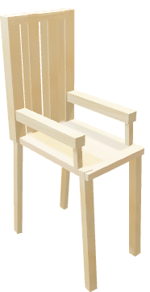
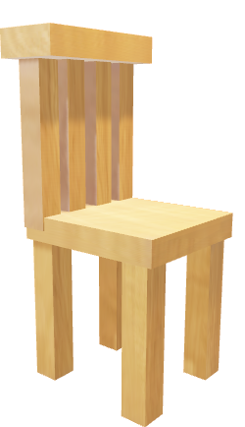
3D GAN
Real 3D Model (Training Set)
Discriminator
Real
Fake
Fake 3D Model
Z
Generator
Random Z Vector
Notes:
Generator – Can sample new 3D models directly from latent space, no input model required
Discriminator –carries informative features for 3D object recognition
Main point: generates models that are novel and realistic

Slide 6
3D GAN(Training)
Notes:
Generator – Can sample new 3D models directly from latent space, no input model required
Discriminator –carries informative features for 3D object recognition
Main point: generates models that are novel and realistic

Slide 7
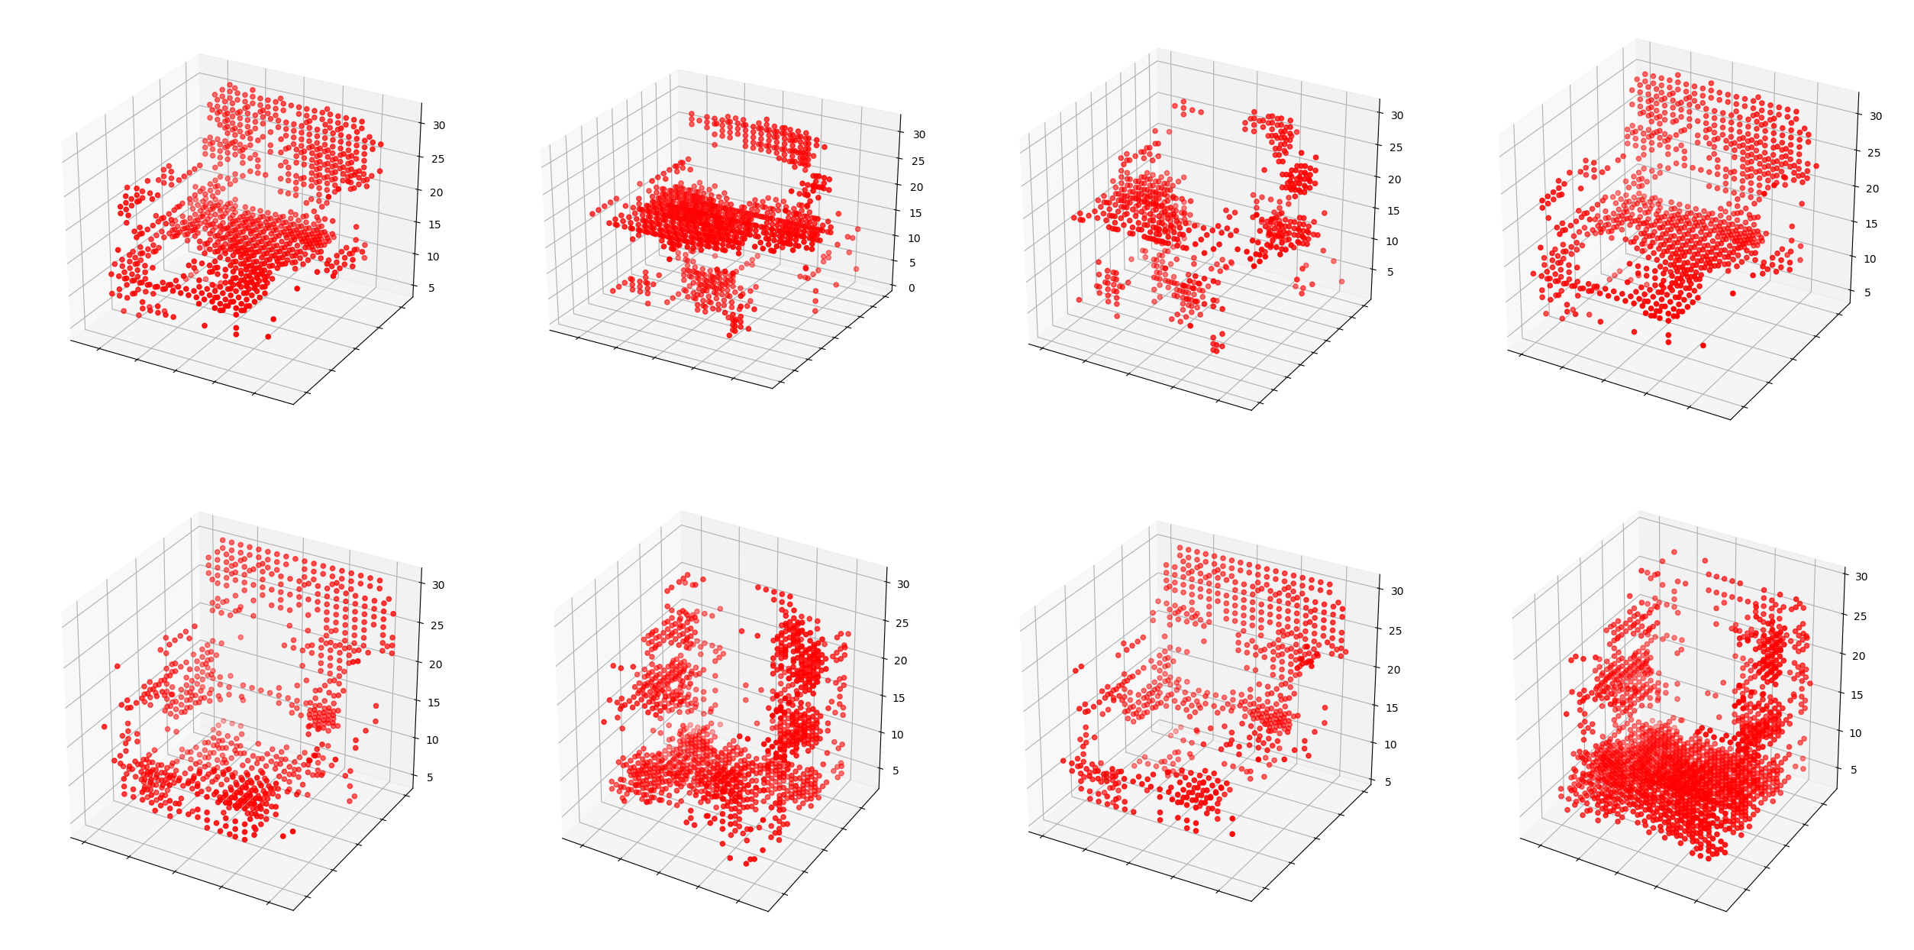
Initial Results
1000 Training Iterations
3DGAN

Slide 8
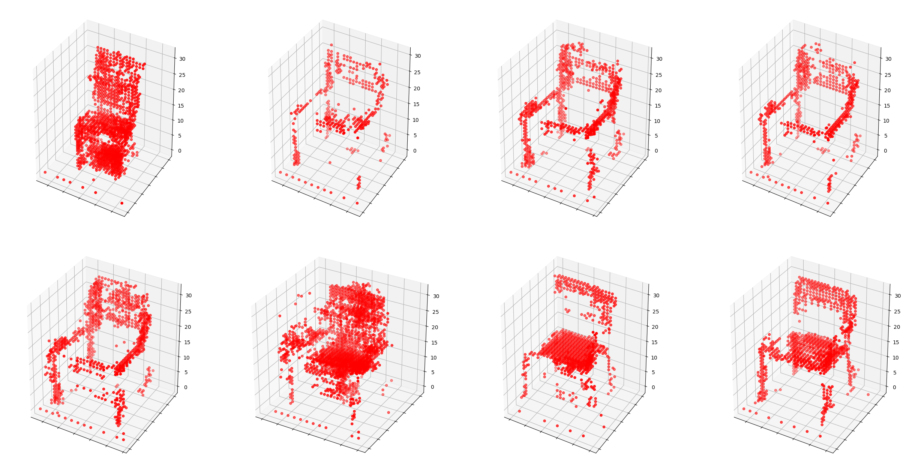
Initial Results
2000 Training Iterations
3DGAN

Slide 9
Conclusion
Synthesizing new and realistic 3D shapes via Adversial Learning
Exploring Latent Space shape
Extracting powerful shape descriptors for classification
Can extend 3D-GAN for single image 3D reconstruction

Slide 10
Thank you!

Slide 11
References
[1] Angel X Chang, Thomas Funkhouser, Leonidas Guibas, et al. Shapenet: An information-rich 3d model repository.arXiv preprint arXiv:1512.03012, 2015.
[2] J. Wu, C. Zhang, T. Xue, B. Freeman, and J. Tenenbaum. Learning a probabilistic latent space of object shapes via 3d generative-adversarial modeling. In NIPS, pages 82–90, 2016.
[3] Ian Goodfellow, Jean Pouget-Abadie, Mehdi Mirza, Bing Xu, David Warde-Farley, Sherjil Ozair, Aaron Courville, and Yoshua Bengio. Generative adversarial nets. In NIPS, 2014.
[4] Zhirong Wu, Shuran Song, Aditya Khosla, Fisher Yu, Linguang Zhang, Xiaoou Tang, and Jianxiong Xiao. 3d shapenets: A deep representation for volumetric shapes. In CVPR, 2015.
[5] https://github.com/rimchang/3DGAN-Pytorch

